Slide 1
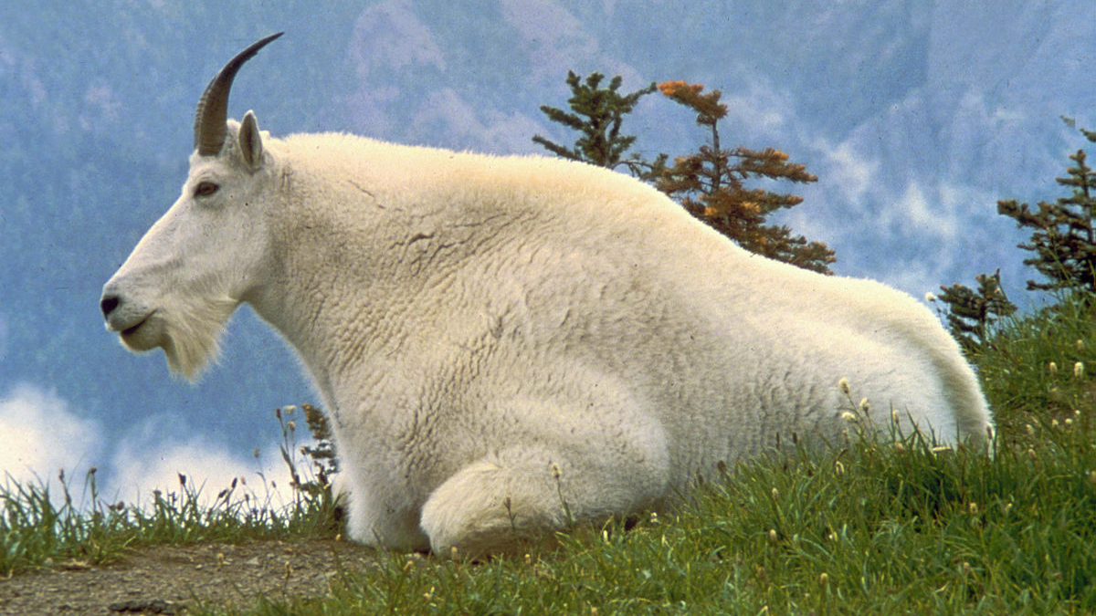
Biogeography of the Mountain Goat (Oreamnos americanus) Chidera Bisong

Slide 2
Taxonomy
Kingdom | Phylum | Class | Order | Family | Genus | Scientific Name
Animalia | Chordata | Mammalia | Artiodactyla | Bovidae | Oreamnos | Oreamnos americanus

Slide 3
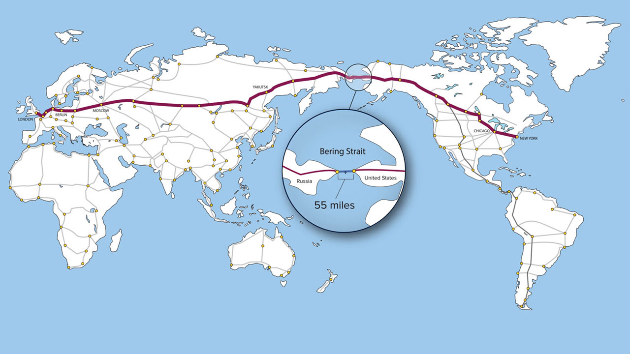
It is believed that the ancestors of the Mountain Goat crossed the Bering land bridge between Siberia and Alaska just before the most recent Wisconsin glaciation.
Mountain Goat fossils dating up to 100,000 years old have been found south of the glacial limit in the United States (Ministry of Environment, Lands and Parks, 2000).
12,000 years ago, two different species of Mountain Goat were present in the southwest United States; Oreamnos americanus and the smaller Oreamnos haringtoni (Ministry of Environment, Lands and Parks, 2000).
When the last Cordilleran ice sheet began to wane, Harington’s goat became extinct and Oreamnos americanus, what we currently know as the Mountain Goat, travelled north to the snowy mountains it favours.

Slide 4
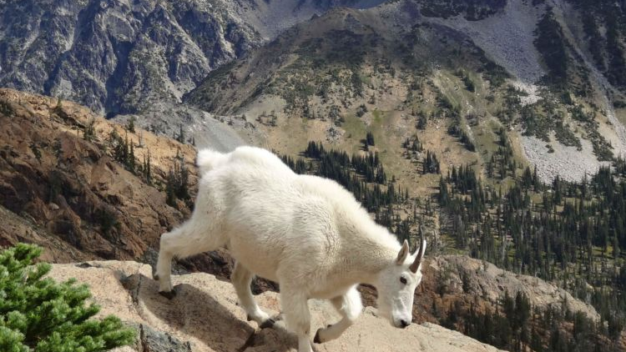
Historical Distribution Through Time
Approx. 12,000 years ago, Mountain Goat was present in the southwest United States (Ministry of Environment, Lands and Parks, 2000).
Early Neolithic economy was mostly based on intensive collection of plants and hunting game (Ministry of Environment BC, 2003), however, this had little or no effect on the Mountain Goat because their habitat is not easily accessible.
The last 200 years – major ecological changes - including the last episode of drastic reduction in forest area (Ministry of Environment BC, 2003), however, this is still of no major concern to the Mountain Goat as they are above timberline most of the time and only occasionally migrate to slightly lower altitudes seasonally.
The Mountain Goat’s present range extends from Oregon and Idaho north to Alaska and the Yukon Territory.

Slide 5
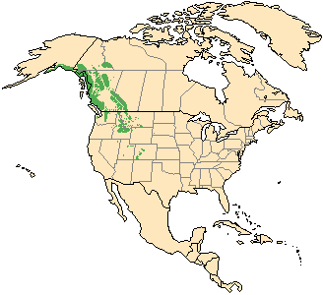
Current Distribution
In the U.S, range extends from western Montana, southern Idaho, and the Columbia River in Washington north along the Rocky Mountains as far as the Chugach and Talkeetna mountains of Alaska (Chester B. et al., 1975).
In Canada, they occupy British Columbia, Alberta and the Yukon Territories. (Ministry of Environment, Lands and Parks, 2000).
From recent estimates, numbers in North America has varied from about 75,000 to 100,000 (Ministry of Environment, Lands and Parks, 2000).
Compiled from Shackleton, 1997

Slide 6
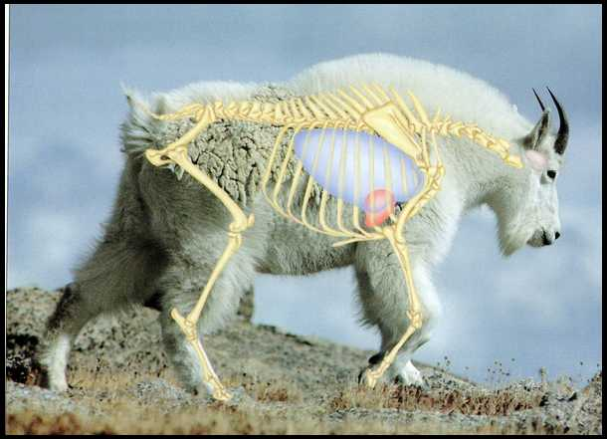
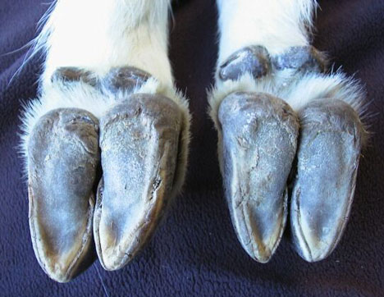
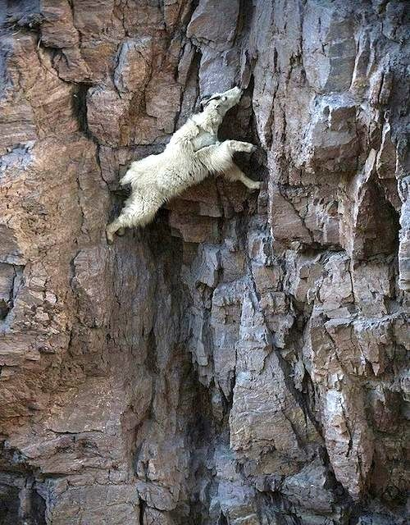
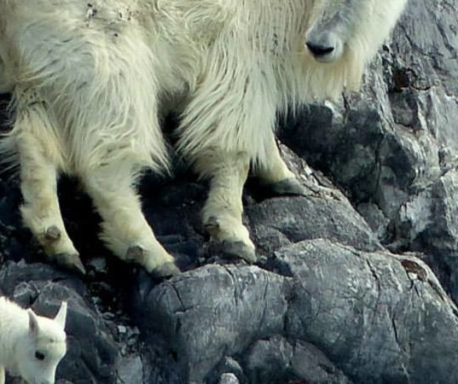
Biological Adaptation
Forequarters are disproportionately massive in relation to its compact rear end.
Legs are short and close together, creating a centre of gravity that is close to the ground, making the animal able to travel on narrow ledges with limited footing.
Cloven hooves are rough-textured traction pads, making them highly specialized for not only rocky, but slippery terrain (Sladek, M., 2017).
Thick winter coat to withstand severe cold.
Notes:
Point 1: Features a deep chest area and tremendously well-developed shoulder muscles. Giving goat extremely great strength for climbing steep rocky slopes endlessly, and for pawing through thick layers of snow for food.

Slide 7


Slide 8
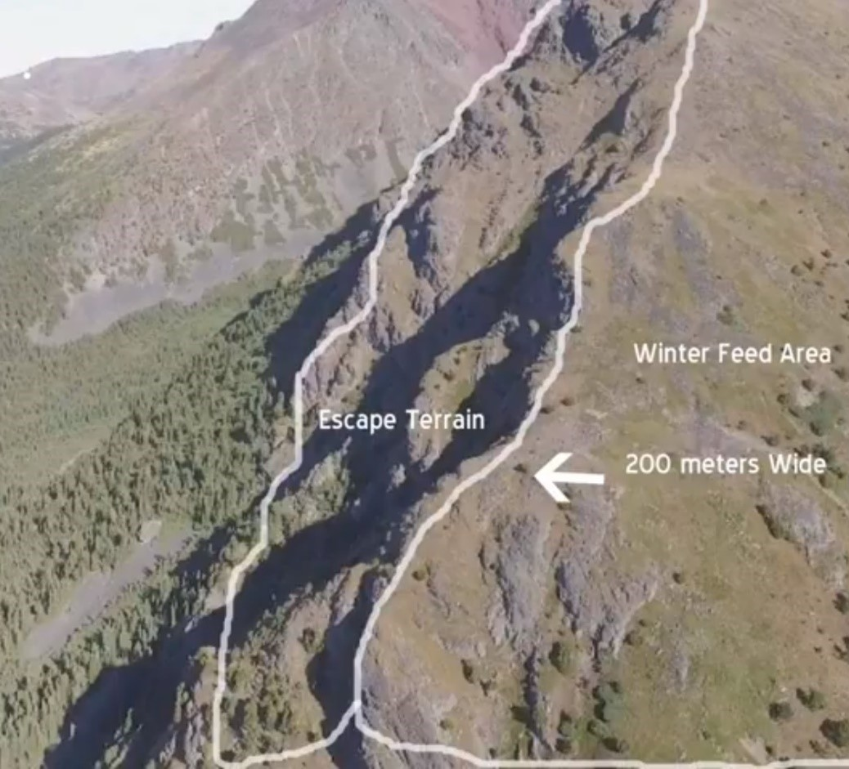
Ecological Adaptation
They make use of escape terrains because they can not run very fast.
In summer they feed on grasses, flowering plants and sedges close to steep cliffs where predators dare not follow. (Rideout & Hoffmann, 1975).
In winter months, they spend a lot of time on steep and narrow ridges, always close to a steep escape terrane in case of a predator strike. (Rideout & Hoffmann, 1975).
They spend all the winter season here, from mid-October until April.
In this way, Mountain Goats create their own winter pasture, and their chosen ranges are especially fertile and suited to keep the herd well fed and healthy all winter (Rideout & Hoffmann, 1975).
Notes:
Point 2: If they spot a predator, they will climb on to steep escape terrain until the predators gives up the chase and leave. Then the goats climb off the steep cliffs and resume feeding.
Point 3: They are natural farmers. They return to the same ridge every winter year after year, on this same parcel of land they urinate and defecate all in that narrow winter area, thus creating nutrients for the grasses during the next growing season and rich plant growth in summer.

Slide 9
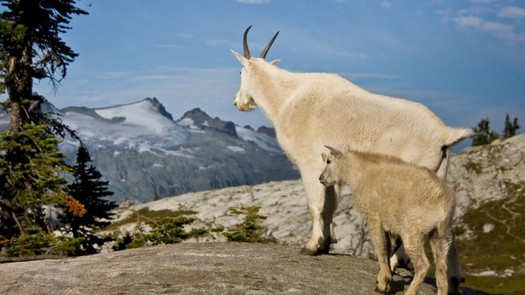
Limiting Factors
Parasites and diseases
Predators - Cougars are their most frequent visitors because of their ability to move well in the steep, rugged terrain where the goats dwell (William et al., 2003).
Adverse weather - Summer precipitation and temperature affect the quantity and the quality of forage availability on goat ranges (William et al., 2003). Weather affects the nutritional condition of goats and their ability to avoid a variety of decimating factors, and to survive and reproduce. - Cold, wet weather, which is common in high country can lead to hypothermia and death of neonatal goats (Brandborg 1955, Chadwick 1983, Johnson 1983).

Slide 10
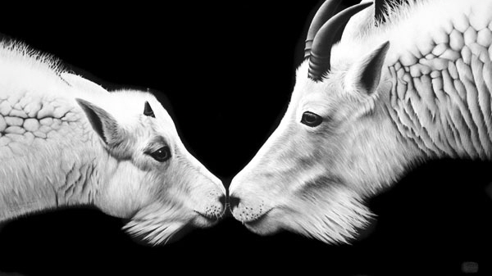
Diseases
This is a list of individual cases observed in different reports:
“Pasteurellosis” - carried in the mouth and respiratory tract (Brandborg 1955).
“Tooth abscess” & one case of “foot rot” - a fungal infection (Cowan 1951).
“Aratuberculosis” - affects the small intestine (Williams et al. 1978).
Neoplasms or tumors – occasionally seen.
Notes:
Cases of contagious ecthyma

Slide 11
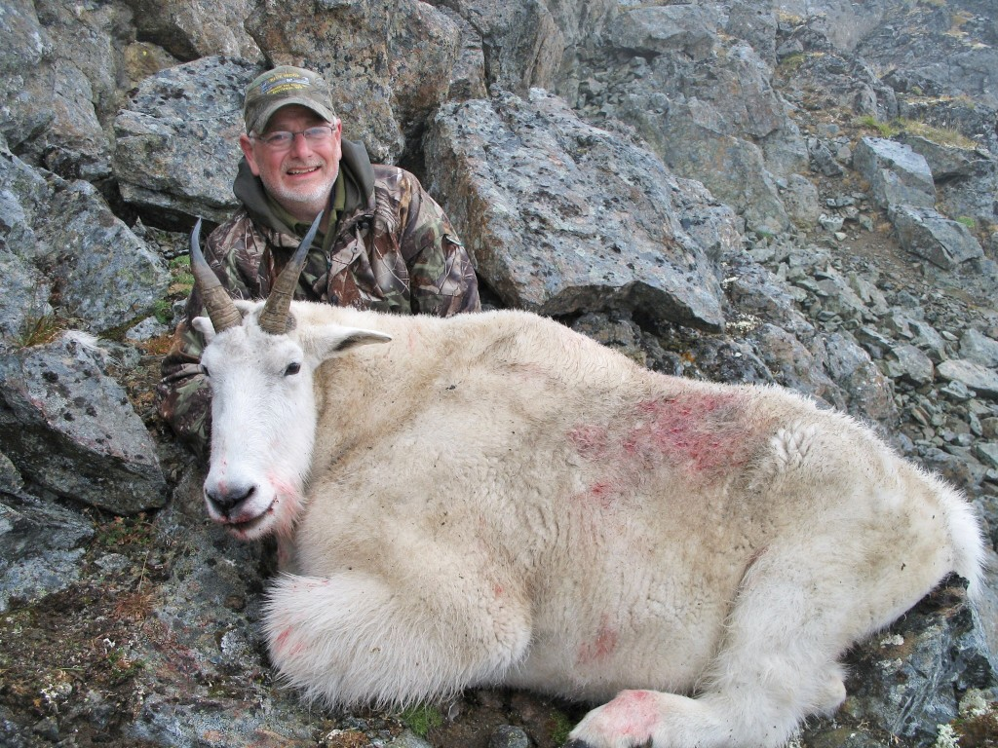
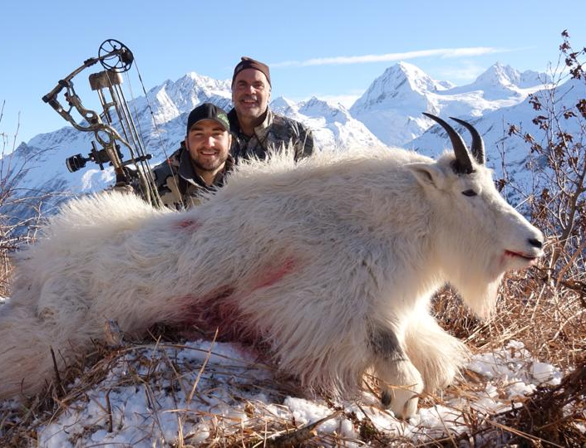
Goats and Humans
Goat Watching - Viewing Mountain Goats is an important part of the wilderness experience for hikers.
Hunting – Game and Trophy hunting.

Slide 12
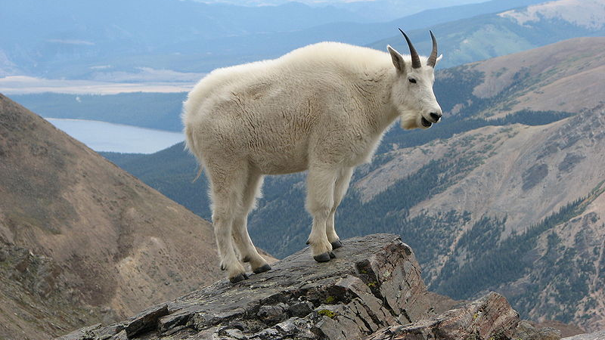
Climate Change
Mountain Goats rely on high, cool, rocky terrain for their survival (Crown of the Continent, 2017).
Because of Climate Change, glacier is currently experiencing warming three times the global average at higher elevations (Crown of the Continent, 2017).
Increased temperatures in the high peaks where Mountain Goats live may influence their habitat and diet (Defenders of Wildlife, 2018).
Mountain Goats normally reproduce at a slow rate, a small loss can be devastating to a population. The kids and yearlings are typically the most vulnerable as many of them do not survive the winter.

Slide 13
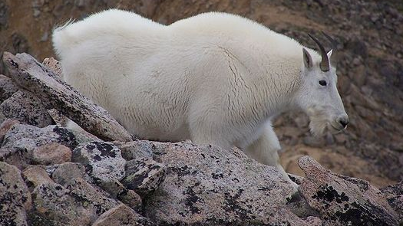
Future Prediction for Distributional Changes
Major activities that have threatened Mountain Goat distribution are generated by humans:
Mining disturbance (British Columbia).
Unintended harassment of goats by helicopters.
Snowmobiles in some areas.

Slide 14
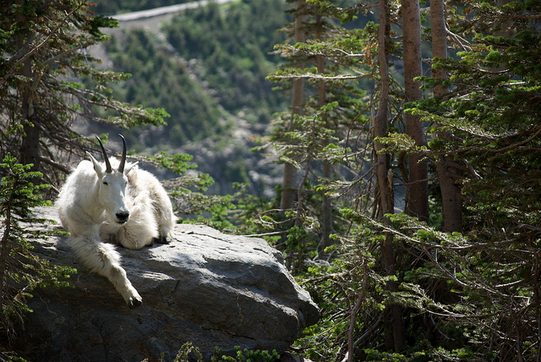
Management Some management goals:
Maintenance of viable, productive and interconnected populations of Mountain Goats throughout their ranges (William et al., 2003).
Maintenance of viable, productive and interconnected habitats for Mountain Goats throughout their ranges (William et al., 2003).
Provision of opportunities for Mountain Goat education, study of Mountain Goats to help increase our knowledge and enhance the conservation and management of the species (William et al., 2003).

Slide 15
Objective
Goal 1: Monitor the distribution, size and age-sex structure of Mountain Goat populations in each management area with the use of established survey protocols and frequencies.
Goal 2: Develop habitat management strategies to protect sufficient habitat to support summer and winter populations for each population area (William et al., 2003).
Goal 3: Partner with post-secondary institutions to foster graduate research on Mountain Goats and provide the necessary logistical and professional support needed for these research projects (William et al., 2003).

Slide 16
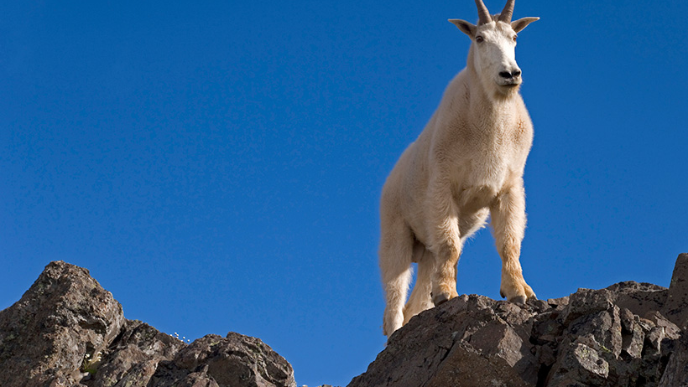
Conservation
Prescribed burning to help the recovery of goat populations (Ministry of Environment, Lands and Parks, 2000).
Regular monitoring of goat numbers.
Careful control of hunting and poaching.
Continued protection of habitat.
Controlling other human actions that deteriorate goat’s wellbeing like, controlling of helicopter flights, motor vehicle access, snowmobiles, and human recreational activities (Ministry of Environment, Lands and Parks, 2000).

Slide 17
Thank You!

Slide 18
References
Nowak, R. M. [editor]. 1991. Walker's Mammals of the World (Fifth Edition). Baltimore: The Johns Hopkins University Press.
E.J. Hugghins, and A.H. Richardson. 1971. Parasites and pesticide residues of mountain goats in South Dakota. Journal of Wildlife Management 35:94-103.
Côté, S.D. 1996. Mountain goat responses to helicopter disturbance. Wildlife Society Bulletin 24:681-685.
Festa-Bianchet, M., M. Urquhart, and K.G. Smith. 1994. Mountain goat recruitment: kid production and survival to breeding age. Canadian Journal of Zoology 72:22-27.
Hibbs, L.D. 1966. A literature review on mountain goat ecology. Colorado Cooperative Wildlife Research Unit Special Report No. 8. 23 p.
Hall, W.K. 1977. Status and management of the Rocky Mountain goat, Oreamnos americanus, in the province of Alberta. Pages 8-14 in W. Samuel and W.G. Macgregor, editors. Proceedings of the First International Mountain Goat Symposium. British Columbia Fish and Wildlife Branch, Victoria.
Gonzalez-Voyer, A., M. Festa-Bianchet, and K.G. Smith. 2001. Efficiency of aerial surveys of mountain goats. Wildlife Society Bulletin 29:140-144.
DeBock, E.A. 1970. On the behavior of the mountain goat (Oreamnos americanus) in Kootenay National Park. M.S. Thesis, University of Alberta, Edmonton. 168 p.
https://defenders.org/mountain-goat/basic-facts
https://gohunt-assets.s3.amazonaws.com/media/mountain-goat_0.jpg
http://www.earthisland.org/journal/index.php/elist/eListRead/nonnative_species_are_posing_management_challenges_in_parks_across_the_us/

Slide 19
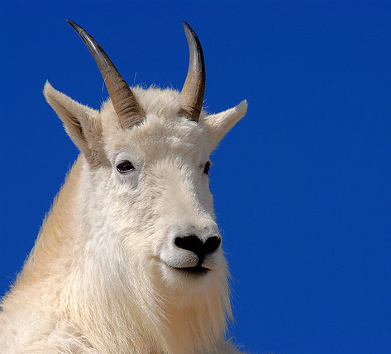
Questions!

